Slide 1

INSTITUTE - UIE
DEPARTMENT- ACADEMIC UNIT-2
Bachelor of Engineering (Computer Science & Engineering)
Subject Name: Object Oriented Programming using C++
Subject Code:20CST151
Unit-2
Inheritance
DISCOVER . LEARN . EMPOWER

Slide 2


Object Oriented Programming using C++
Course Objectives
To enable the students to understand various stages and constructs of C++ programming language and relate them to engineering programming problems.
To improve their ability to analyze and address variety of problems in programming domains.

Slide 3


Course Outcomes
CO Number | Title | Level
CO1 | Provide the environment that allows students to understand object-oriented programming Concepts. | Understand
CO2 | Demonstrate basic experimental skills for differentiating between object-oriented and procedural programming paradigms and the advantages of object-oriented programs. | Remember
CO3 | Demonstrate their coding skill on complex programming concepts and use it for generating solutions for engineering and mathematical problems. | Understand
CO4 | Develop skills to understand the application of classes, objects, constructors, destructors, inheritance, operator overloading and polymorphism, pointers, virtual functions, exception handling, file operations and handling. | Understand
Will be covered in this lecture

Slide 4
Scheme of Evaluation
Sr. No. | Type of Assessment Task | Weightage of actual conduct | Frequency of Task | Final Weightage in Internal Assessment (Prorated Marks) | Remarks
1. | Assignment* | 10 marks of each assignment | One Per Unit | 10 marks | As applicable to course types depicted above.
2. | Time Bound Surprise Test | 12 marks for each test | One per Unit | 4 marks | As applicable to course types depicted above.
3. | Quiz | 4 marks of each quiz | 2 per Unit | 4marks | As applicable to course types depicted above.
4. | Mid-Semester Test** | 20 marks for one MST. | 2 per semester | 20 marks | As applicable to course types depicted above.
5. | Presentation*** |  |  | Non Graded: Engagement Task | Only for Self Study MNGCourses.
6. | Homework | NA | One per lecture topic (of 2 questions) | Non-Graded: Engagement Task | As applicable to course types depicted above.
7. | Discussion Forum | NA | One per Chapter | Non Graded: Engagement Task | As applicable to course types depicted above.
8. | Attendance and Engagement Score on BB | NA | NA | 2 marks

Slide 5
CONTENTS
Defining derived class,
modes of inheritance,
types of inheritance,
ambiguity in inheritance,
virtual base class,
Function overriding,
Member Classes: Nesting of Classes.
The capability of a class to derive properties and characteristics from another class is called Inheritance.
Inheritance is one of the most important feature of Object Oriented Programming

Slide 6
FUNCTION OVERRIDING
If the derived class has the function with same name as the function in the base class, then it will hide the function of base class.
If we inherit a class into the derived class and provide a definition for one of the base class's function again inside the derived class, then that function is said to be overridden, and this mechanism is called Function Overriding
REQUIREMENTS FOR OVERRIDING-
Inheritance should be there. Function overriding cannot be done within a class. For this we require a derived class and a base class.
Function that is redefined must have exactly the same declaration in both base and derived class, that means same name, same return type and same parameter list.
IN SHORT: If derived class defines same function as defined in its base class, it is known as function overriding in C++. It is used to achieve runtime polymorphism. It enables you to provide specific implementation of the function which is already provided by its base class.

Slide 7
Function Overloading Vs. Function Overriding
Function Overloading happens in the same class when we declare same functions with different arguments in the same class.
Function Overriding is happens in the child class when child class overrides parent class function.
Function overriding is a feature that allows us to have a same function in child class which is already present in the parent class. A child class inherits the data members and member functions of parent class, but when you want to override a functionality in the child class then you can use function overriding.

Slide 8
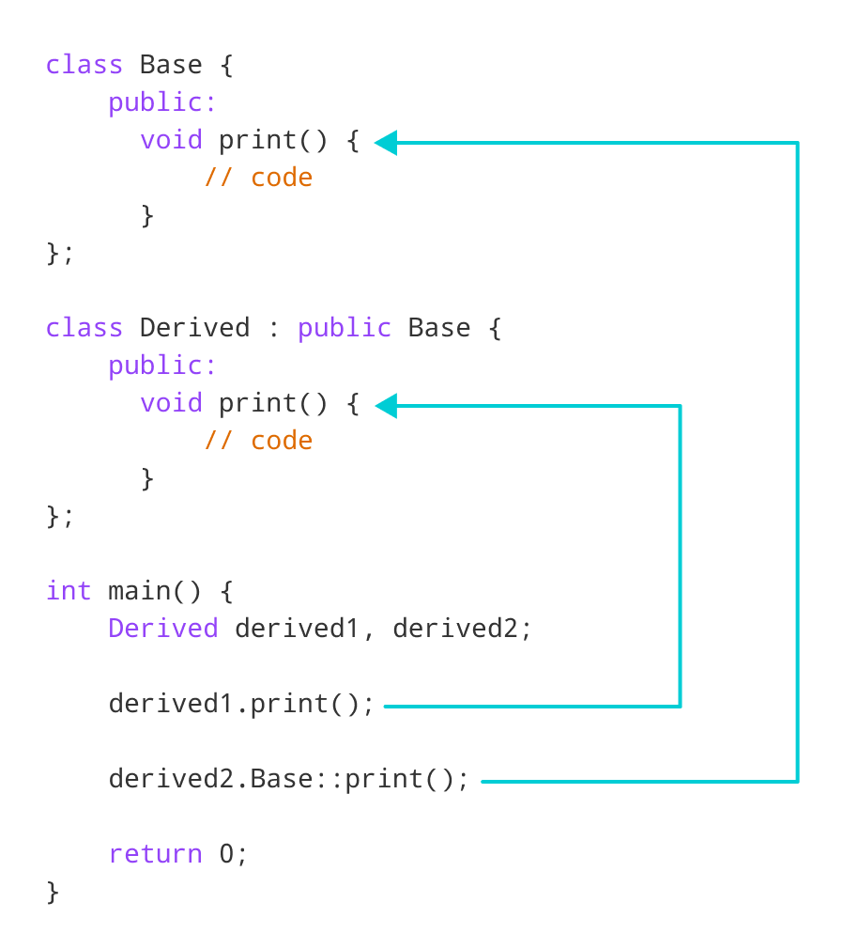

Slide 9
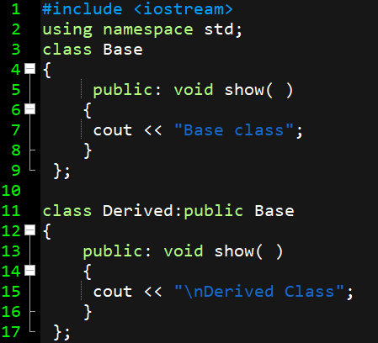
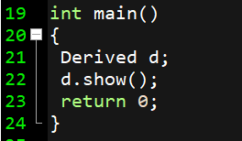
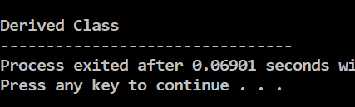
EXAMPLE # 1 - FUNCTION OVERRIDING
Figure 4.17 Program made on Dev-C++
Notes:
#include <iostream>
using namespace std;
class Base
{
public: void show( )
{
cout << "Base class";
}
};
class Derived:public Base
{
public: void show( )
{
cout << "\nDerived Class";
}
};
int main()
{
Base b;
Derived d;
b.show();
d.show();
return 0;
}

Slide 10
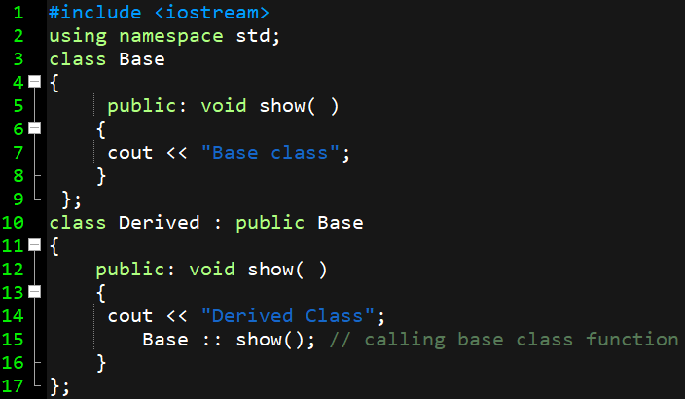
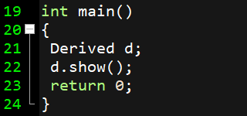
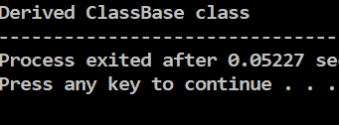
FUNCTION OVERRIDING - SOLUTION
Figure 4.18 Program made on Dev-C++
Notes:
#include <iostream>
using namespace std;
class Base
{
public: void show( )
{
cout << "Base class";
}
};
class Derived : public Base
{
public: void show( )
{
cout << "Derived Class";
Base :: show(); // calling base class function
}
};
int main()
{
Derived d;
d.show();
return 0;
}

Slide 11
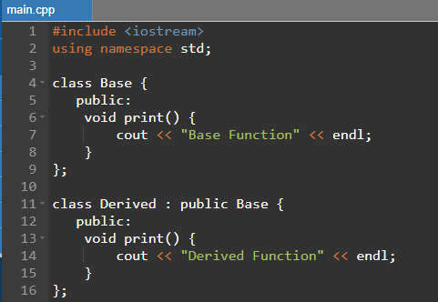
EXAMPLE # 2 - FUNCTION OVERRIDING

Slide 12

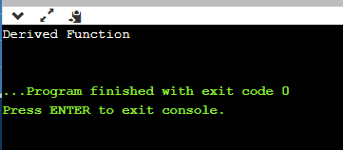
SOLUTION

Slide 13
NESTING OF CLASSES
A nested class is a member and as such has the same access rights as any other member.
The name of the nested class exists in the scope of the enclosing class, and name lookup from a member function of a nested class visits the scope of the enclosing class after examining the scope of the nested class.
Like any member of its enclosing class, the nested class has access to all names (private, protected, etc) to which the enclosing class has access, but it is otherwise independent and has no special access to the this pointer of the enclosing class.
A nested class is declared within the scope of another class. The name of a nested class is local to its enclosing class.
A member function can call another member function of the same class directly without using the dot operator. This is called as nesting of member functions. Nesting of member functions. You know that only the public members of a class can be accessed by the object of that class, using dot operator
Why do we need nested classes?
Nested classes represent a special type of relationship that is it can access all the members (data members and methods) of outer class including private.
Nested classes are used to develop more readable and maintainable code because it logically group classes and interfaces in one place only.

Slide 14
NESTING OF CLASSES
A nested class is a class that is declared in another class. The nested class is also a member variable of the enclosing class and has the same access rights as the other members
Nested classes can be forward-declared and later defined, either within the same enclosing class body, or outside of it[4]:
class enclose {
class nested1; // forward declaration
class nested2; // forward declaration
class nested1 {}; // definition of nested class
};
class enclose::nested2 { }; // definition of nested class
They enable you to logically group classes that are only used in one place, thus this increases the use of encapsulation, and create more readable and maintainable code.

Slide 15
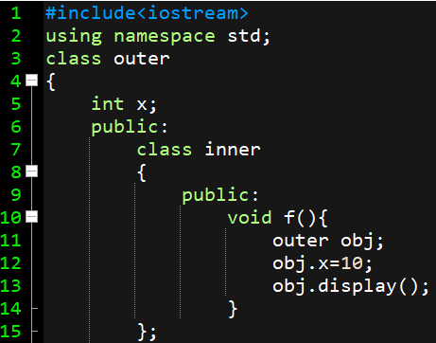
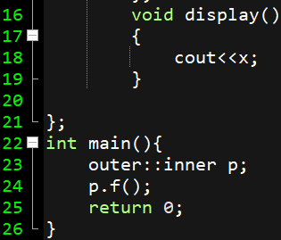
NESTING OF CLASSES-EXAMPLE 1
A nested class is a class which is declared in another enclosing class.
A nested class is a member and as such has the same access rights as any other member.
The members of an enclosing class have no special access to members of a nested class; the usual access rules shall be obeyed.
Figure 4.25 Program made on Dev-C++

Slide 16
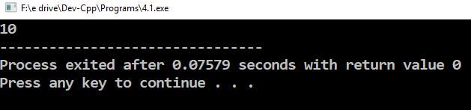
OUTPUT
Figure 4.26 Program OUTPUT made on Dev-C++

Slide 17
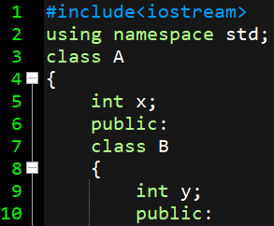
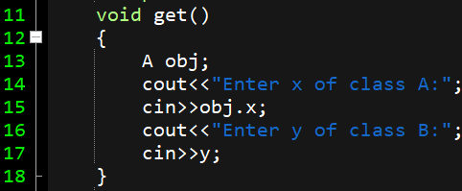
NESTING OF CLASSES-EXAMPLE 2
A nested class is a class which is declared in another enclosing class.
Figure 4.27 Program made on Dev-C++

Slide 18
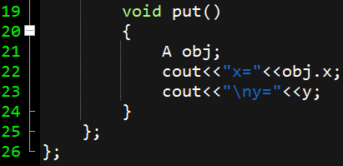
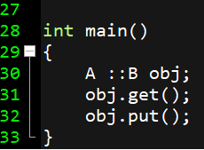
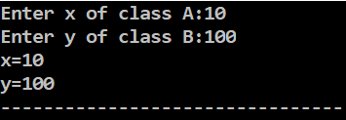
NESTING OF CLASSES-EXAMPLE 2
Figure 4.28 Program made on Dev-C++

Slide 19
Assessment Questions
(a) Write a C++ program to represent the function overriding using AVERAGE() function.
(b) Why function overriding is required?
(c) What is nesting of classes?
Write a C++ program to demonstrate nesting of classes.
What do you mean by nesting of member functions?
What is nesting of classes? Explain with a C++ program.

Slide 20
APPLICATIONS
We use nested classes to reflect and to enforce the relationship between two classes.
We should define a class within another class when the nested class makes sense only in the context of its enclosing class or when it relies on the enclosing class for its function.
For example, a text cursor might make sense only in the context of a text component.
A nested class is a class that is declared in another class.
The nested class is also a member variable of the enclosing class and has the same access rights as the other members.
However, the member functions of the enclosing class have no special access to the members of a nested class.

Slide 21
Frequently Asked Questions: -
How do you declare a nested class in C++?
Can you avoid complex nesting?
Which feature of OOP reduces the use of nested classes?
How many categories are nested classes divided into?
Non-static nested classes have access to which members from enclosing class?
What are the advantages/disadvantages of nested classes?

Slide 22
SUMMARY
If a class is defined inside another class, the inner class is termed as nested class. The inner class is local to the enclosing class. Scope matters a lot here.
Using inheritance we can have the security of the class being inherited. The subclass can access the members of parent class. And have more feature than a nested class being used.
The nested classes are divided into two main categories. Namely, Static and non-static. The categories define how the classes can be used inside another class.
The non-static nested class can access all the members of the enclosing class. All the data members and member functions can be accessed from the nested class. Even if the members are private, they can be accessed.
The static nested class doesn’t have access to any other members of the enclosing class. This is a rule that is made to ensure that only the data which can be common to all the object is being accessed by the static nested class.

Slide 23

REFERENCES
Reference Website
[1] https://www.geeksforgeeks.org/inheritance-in-c/
[2] https://www.geeksforgeeks.org/object-oriented-programming-in-cpp/
[3] https://www.geeksforgeeks.org/copy-constructor-argument-const/
[4] https://en.cppreference.com/w/cpp/language/nested_types
References on YouTubes
[1] https://www.youtube.com/watch?v=rr7HVs4d1Qo
[2] https://www.youtube.com/watch?v=5pJyKzON8Ww
[3] https://www.youtube.com/watch?v=RO1ZYW9NAzg
References books
[1] Object-Oriented Programming in C++, by Robert Lafore
[2] Object-Oriented Programming Using C++, by Joyce Farrell
[3] Object-Oriented Programming Using C++, by Pohl

Slide 24
THANK YOU

